Slide 1
Describing Images Using Attributes

Slide 2
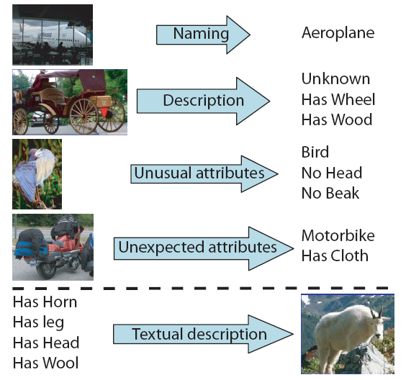
Describing Images
Farhadi et.al. CVPR 2009

Slide 3
Describing Objects by their Attributes
No examples from these object categories were seen during training
Farhadi et.al. CVPR 2009

Slide 4
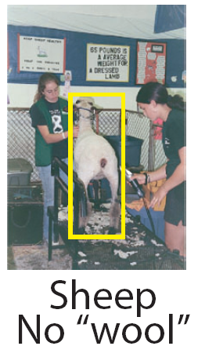
Absence of typical attributes
752 reports
68% are correct
Farhadi et.al. CVPR 2009

Slide 5
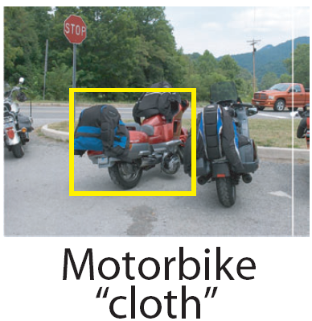
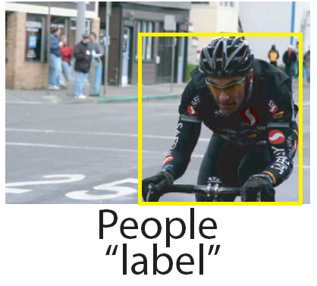
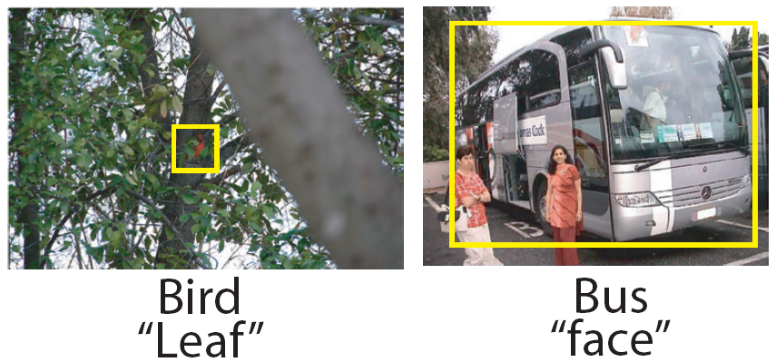
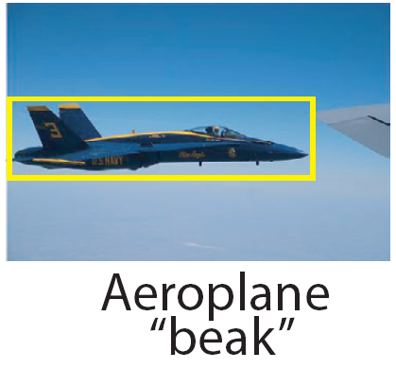
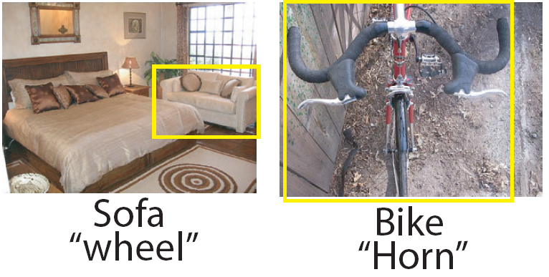
Presence of atypical attributes
951 reports
47% are correct
Farhadi et.al. CVPR 2009

Slide 6
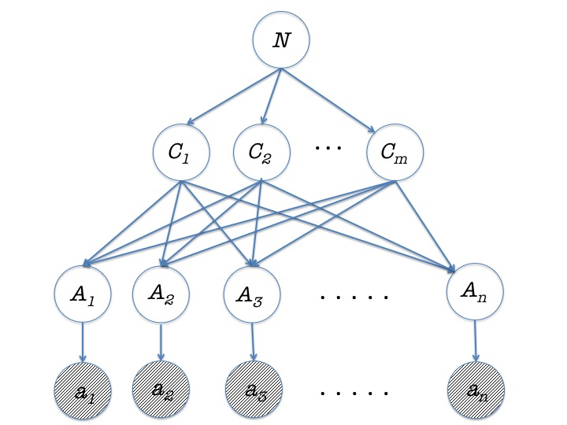
Normality
Saleh et. al. Object Centric Anomalty Detection by Attribute-Based Reasoning, CVPR13

Slide 7
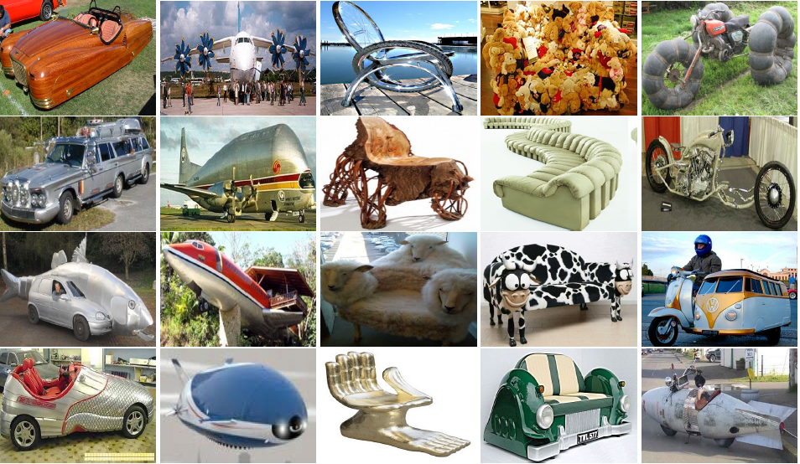
Abnormal Object Dataset
Saleh et. al. Object Centric Anomalty Detection by Attribute-Based Reasoning, CVPR13

Slide 8
Abnormality Prediction and Ranking
Method | AUC
One class SVM | 0.5980
Two class SVM | 0.8657
Graphical Model | 0.8703
Our Model with surprise score | 0.9105
Based on Abnormality Score, we can classify an object as Normal vs. Abnormal.
Also, using this score we are able to rank images based on how strange they look like.
Less Abnormal
High Abnormal
Saleh et. al. Object Centric Anomalty Detection by Attribute-Based Reasoning, CVPR13

Slide 9
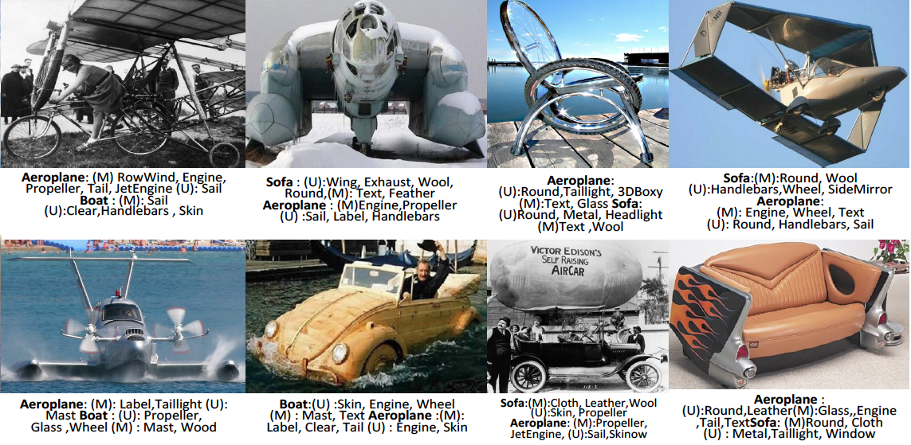
Reasoning about Abnormality via Attributes
Saleh et. al. Object Centric Anomalty Detection by Attribute-Based Reasoning, CVPR13

Slide 10
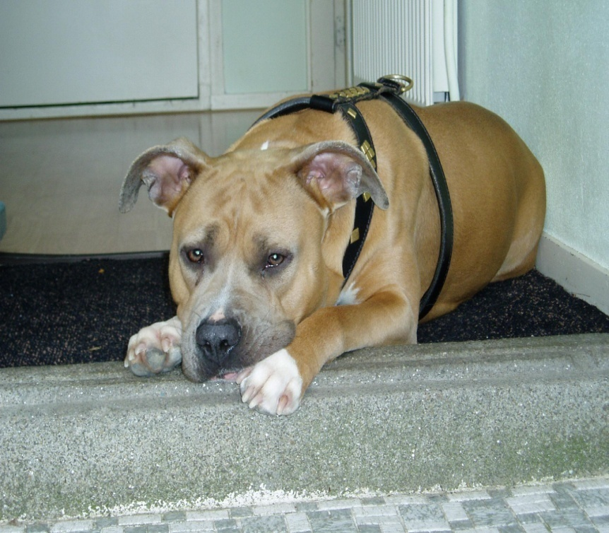
Describing Objects
Detector input
Strongest category response with good overlap
Strongest part response within each spatial bin
Farhadi et. al, Attribute-Centric Recognition for Cross-Category Generalization, CVPR10

Slide 11
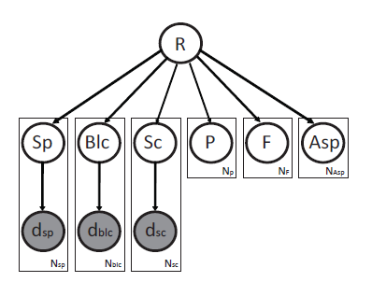
Describing Objects
Learn spatial correlations and co-occurrence
True Value for Categories and Spatial Parts
Latent “Root”
Has Part
Has Function
Pose/Viewpoint
Detector Responses
Learned by EM in training
Farhadi et. al, Attribute-Centric Recognition for Cross-Category Generalization, CVPR10

Slide 12
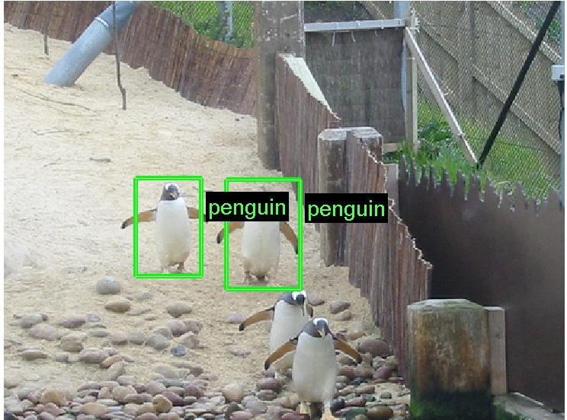
Describing Familiar Objects
Animal
blc: eagle
function: can bite
function: can fly
function: is predator
function: is carnivorous
part: eye
part: foot
part: head
part: leg
part: mouth
part: wing
Pose: extended_wings
Pose: objects_front
animal
function: can bite
function: can fly
part: eye
part: foot
part: head
part: leg
part: mouth
part: tail
part: wing
Pose: objects_front
Farhadi et. al, Attribute-Centric Recognition for Cross-Category Generalization, CVPR10

Slide 13
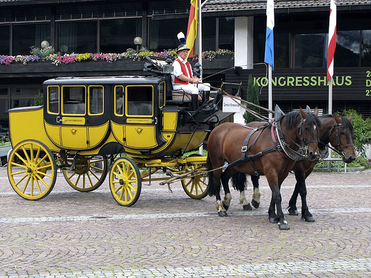
Using Localized Attributes
Animal
Vehicle
Four-legged
Mammal
Head
Wheel
Leg
Can run
Can Jump
Is Herbivorous
Facing right
Moves on road
Facing right
Farhadi et. al, Attribute-Centric Recognition for Cross-Category Generalization, CVPR10

Slide 14
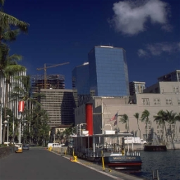
Using Relative Attributes
Binary (existing):
Not natural
Not open
Has perspective
Relative (ours):
More natural than insidecity
Less natural than highway
More open than street
Less open than coast
Has more perspective than highway
Has less perspective than insidecity
Parikh, Grauman, Relative Attributes, ICCV 2011

Slide 15
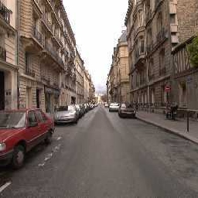
Using Relative Attributes
Binary (existing):
Not natural
Not open
Has perspective
Relative (ours):
More natural than tallbuilding
Less natural than forest
More open than tallbuilding
Less open than coast
Has more perspective than tallbuilding
Parikh, Grauman, Relative Attributes, ICCV 2011

Slide 16
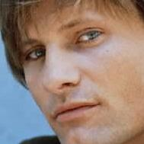
Using Relative Attributes
Binary (existing):
Not Young
BushyEyebrows
RoundFace
Relative (ours):
More Young than CliveOwen
Less Young than ScarlettJohansson
More BushyEyebrows than ZacEfron
Less BushyEyebrows than AlexRodriguez
More RoundFace than CliveOwen
Less RoundFace than ZacEfron
(Viggo)
Parikh, Grauman, Relative Attributes, ICCV 2011

